Slide 1
Games to A.I.
ITAI 1370 Module 03 Spring 2024

Slide 2
Latest News

Slide 3
Last Class Recap

Slide 4
Key Points
1. Historical Context
Early games like chess and Go served as benchmarks for computational complexity.
2. Algorithm Development
Algorithms like Minimax and Alpha-Beta Pruning were developed to tackle game decision trees.
3. Problem-Solving Framework
Games provided a closed environment with defined rules for testing AI strategies.
4. Learning Mechanisms
Techniques like Reinforcement Learning and Neural Networks were fine-tuned using games.
5. Human-AI Interaction
Games like poker showcased the necessity of bluffing and understanding human psychology.
6. Real-world Applications
Game algorithms extend to fields like robotics, finance, and healthcare
Notes:
Historical Context
Early games like chess and Go served as benchmarks for computational complexity.
2. Algorithm Development
Algorithms like Minimax and Alpha-Beta Pruning were developed to tackle game decision trees.
3. Problem-Solving Framework
Games provided a closed environment with defined rules for testing AI strategies.
4. Learning Mechanisms
Techniques like Reinforcement Learning and Neural Networks were fine-tuned using games.
5. Human-AI Interaction
Games like poker showcased the necessity of bluffing and understanding human psychology.
6. Real-world Applications
Game algorithms extend to fields like robotics, finance, and healthcare

Slide 5

The Foundational Role of Games in AI
"Historically, games have been the arenas where AI's capabilities were put to the test. From the early days of chess to the modern, sophisticated games, each has played a pivotal role in shaping AI's strategic development. Today, we explore this rich history and its impact on AI's evolutionary path.".
Notes:
"Today, we're diving into the fascinating world where games and AI converge. We'll explore how games have not only been a playground for AI development but how AI is now revolutionizing the gaming industry.“
"Games have served as a benchmark for AI's capabilities since the inception of AI research. Pioneering projects like IBM's Deep Blue have not only demonstrated AI's potential but also set a precedent for future advancements."

Slide 6
Game Development
Early Beginnings
1950s-1960s: Pioneering experiments; "OXO" and "Spacewar!" as examples.
The Arcade Era
1970s: Iconic games like "Pong" and "Pac-Man" introduced.
Home Consoles
Late 1970s-1980s: Home consoles like Atari 2600, NES popularized.

Slide 7
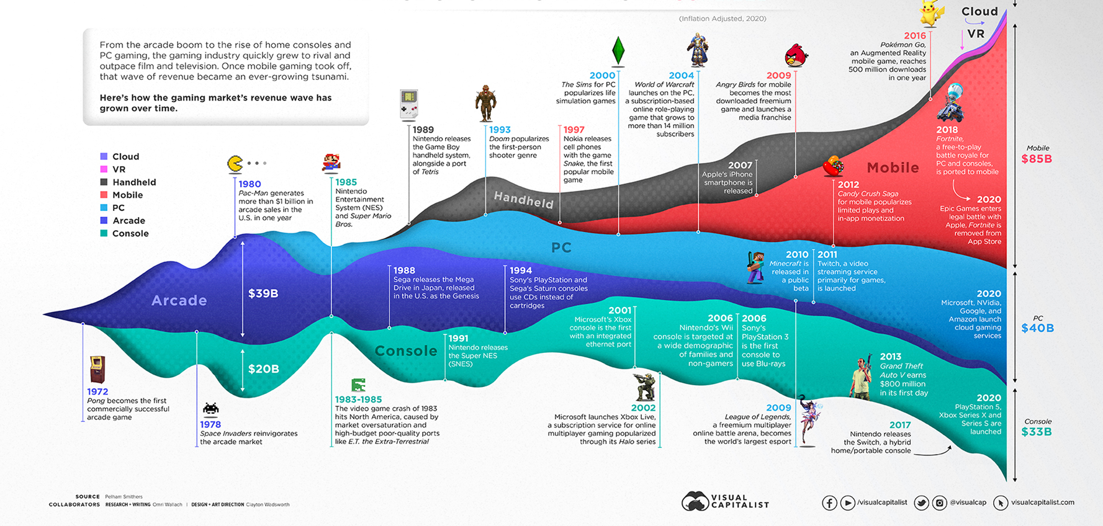
A little Bit of History

Slide 8

Early Days
Board games like chess presented the first challenges to AI, focusing on strategic planning and decision-making. The success of AI in these games laid the groundwork for more complex challenges and highlighted the need for advanced decision-making frameworks.

Slide 9
Evolving Complexity in Games
"As games evolved to become more complex, they demanded AI to adapt and develop more sophisticated algorithms. This slide delves into how the increasing complexity in games pushed AI to evolve from simple decision trees to more complex strategies, incorporating elements of learning and adaptation."

Slide 10
A.I. in Games Milestones
1. Real-Time Strategy AI: Google's DeepMind's AlphaStar, which defeated top human players in StarCraft II.
2. Adaptive Difficulty: Games are now adjusting their difficulty levels in real-time to maintain player engagement.
Cooperative Multiplayer AI: OpenAI's Dota 2 bots that can cooperate with human players against other bots.
4. Conversational Agents: More sophisticated dialog systems in role-playing games.
5. Generative Design: AI algorithms help in creating levels, characters, and even storylines

Slide 11
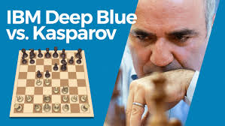
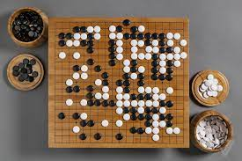
AI's Mastery Over Strategic Games
https://www.youtube.com/watch?v=KF6sLCeBj0s
Kasparov vs Big Blue
Watson vs. Jeopardy champs:
Ken Jennings and Brad Rutter.
Google Deep Minds & the Game of Go
Notes:
AI's journey in gaming reached a pivotal moment when it started mastering complex strategic games. This slide focuses on landmark achievements such as IBM's Deep Blue and Google's AlphaGo, emphasizing how these milestones were made possible by advancements in decision theory and algorithmic development.“
Perhaps the best-known example of deep learning is DeepMind’s AlphaGo.1 Go is a board game similar to Chess. AlphaGo was the first computer program to beat a professional Go player. In March 2016, it beat the top Korean professional, Lee Sedol, in a match watched by more than two hundred million people. The following year, in 2017, AlphaGo beat the world’s No. 1 ranking player, China’s Ke Jie. In 2016 AlphaGo’s success was very surprising. At the time, most people expected that it would take many more years of research before a computer would be able to compete with top level human Go players. It had been known for a long time that programming a computer to play Go was much more difficult than programming it to play Chess. There are many more board configurations possible in Go than there are in Chess. This is because Go has a larger board and simpler rules than Chess. There are, in fact, more possible board configurations in Go than there are atoms in the universe. This massive search space and Go’s large branching factor (the number of board configurations that can be reached in one move) makes Go an incredibly challenging game for both humans and computers. One way of illustrating the relative difficulty Go and Chess presented to computer programs is through a historical comparison of how Go and Chess programs competed with human players. In 1967, MIT’s MacHack-6 Chess program could successfully compete with humans and had an Elo rating2 well above novice level, and, by May 1997, DeepBlue was capable of beating the Chess world champion Gary Kasparov. In comparison, the first complete Go program wasn’t written until 1968 and strong human players were still able to easily beat the best Go programs in 1997. The time lag between the development of Chess and Go computer programs reflects the difference in computational difficulty between these two games. However, a second historic comparison between Chess and Go illustrates the revolutionary impact that deep learning has had on the ability of computer programs to compete with humans at Go. It took thirty years for Chess programs to progress from human level competence in 1967 to world champion level in 1997. However, with the development of deep learning it took only seven years for computer Go programs to progress from advanced amateur to world champion; as recently as 2009 the best Go program in the world was rated at the low-end of advanced amateur. This acceleration in performance through the use of deep learning is nothing short of extraordinary, but it is also indicative of the types of progress that deep learning has enabled in a number of fields. AlphaGo uses deep learning to evaluate board configurations and to decide on the next move to make. The fact that AlphaGo used deep learning to decide what move to make next is a clue to understanding why deep learning is useful across so many different domains and applications. Decision-making is a crucial part of life. One way to make decisions is to base them on your “intuition” or your “gut feeling.” However, most people would agree that the best way to make decisions is to base them on the relevant data. Deep learning enables data-driven decisions by identifying and extracting patterns from large datasets that accurately map from sets of complex inputs to good decision outcomes.
Kelleher, John D.. Deep Learning (The MIT Press Essential Knowledge series) (pp. 2-4). MIT Press. Kindle Edition.
1968 and strong human players were still able to easily beat the best Go programs in 1997 . The time lag between the development of Chess and Go computer programs reflects the difference in computational difficulty between these two games . However , a second historic comparison between Chess and Go illustrates the revolutionary impact that deep learning has had on the ability of computer programs to compete with humans at Go . It took thirty years for Chess programs to progress from human level competence in 1967 to world champion level in 1997 . However , with the development of deep learning it took only seven years for computer Go programs to progress from advanced amateur to world champion ; as recently as 2009 the best Go program in the world was rated at the low - end of advanced amateur . This acceleration in performance through the use of deep learning is nothing short of extraordinary , but it is also indicative of the types of progress that deep learning has enabled in a number of fields . AlphaGo uses deep learning to evaluate board configurations and to decide on the next move to make . The fact that AlphaGo used deep learning to decide what move to make next is a clue to understanding why deep learning is useful across so many different domains and applications . Decision - making is a crucial part of life . One way to make decisions is to base them on your “ intuition ” or your “ gut feeling . ” However , most people would agree that the best way to make decisions is to base them on the relevant data .

Slide 12
Decision Theory & Games Theory
Decision theory focuses on making optimal decisions in uncertain condition.
Game theory focuses on strategic interactions between multiple rational agents.
Both are fundamental to various AI applications for designing intelligent, rational agents.

Slide 13
Decision Theory & Games Theory
Decision theory focuses on making optimal decisions in uncertain condition.
Game theory focuses on strategic interactions between multiple rational agents.
Both are fundamental to various AI applications for designing intelligent, rational agents.

Slide 14

Decision Theory in Gaming
Decision theory forms the backbone of AI's strategic planning.
Introduction to Decision Theory:
Foundation of rational choice-making in uncertain scenarios.
Balances risks and rewards to determine optimal strategies.
Significance in Gaming:
Enhances game complexity and realism.
Models strategic interactions between players and AI.
Simulates human-like decision-making for non-player characters (NPCs).
Notes:
Decision theory is a multifaceted field of study that deals with the processes of making decisions in a formal mathematical context. It touches on aspects of psychology, economics, statistics, philosophy, computer science, and management science, among others. The branches or subfields of decision theory can vary depending on how one chooses to categorize them, but some common ones include:
Normative Decision Theory
This branch is concerned with identifying the best decision to make, assuming an ideal decision maker who is fully rational and aims to maximize utility. It focuses on developing models and rules that prescribe how decisions should be made.
Descriptive Decision Theory
This branch aims to describe how people actually make decisions rather than how they should make decisions. It often involves empirical observations and experiments to understand real-world decision-making processes, including the role of biases, heuristics, and emotional factors.
Prescriptive Decision Theory
Prescriptive decision theory aims to bridge the gap between normative and descriptive theories by recommending methods and procedures to help real-world decision-makers arrive at better decisions. This involves recognizing the limitations and biases in human decision-making and providing strategies to mitigate them.
Bayesian Decision Theory
This is a mathematical framework for decision-making that incorporates Bayesian probability. It assumes that the decision-maker can assign probabilities to different outcomes and uses these to make the best decision under uncertainty.
Game Theory
Game theory is sometimes considered a branch of decision theory or a closely related field. It focuses on situations involving multiple decision-makers, known as players, whose decisions impact each other.
Behavioral Economics
This branch studies the impact of psychological and social factors on the economic decisions of individuals and institutions and how those decisions deviate from traditional theories of economic behavior. It borrows heavily from both normative and descriptive decision theory.
Multi-criteria Decision Analysis (MCDA)
This branch focuses on decision-making problems where multiple criteria must be considered. MCDA methods are designed to handle trade-offs between competing objectives.
Operations Research
Though more of an interdisciplinary field than a branch of decision theory, operations research often employs decision-theoretic models to solve complex organizational, logistical, or resource-based problems.
Computational Decision Theory
This focuses on the application of computational methods, including machine learning and artificial intelligence, to aid in decision-making processes. These methods may be applied to optimize decisions in systems, predict human decision-making, or even to simulate decision-making in artificial agents.
Ethical and Social Decision Theory
This is a more philosophical branch that addresses the ethical implications of decision-making. It questions how values, norms, and societal pressures impact the decisions individuals or organizations make.
Stochastic Decision Processes
These are mathematical models that involve decision-making under uncertainty. Markov Decision Processes (MDPs) are a common example, used widely in economics, computer science, engineering, and other fields.
Different subfields often overlap and researchers may work in multiple areas concurrently. Decision theory as a whole provides the tools and frameworks to tackle a wide array of problems where choices must be made.

Slide 15
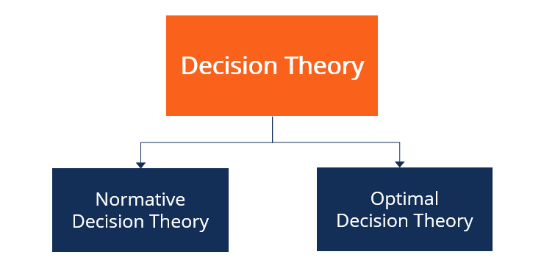
Decision Theory
Structured Framework for AI:
Guides AI in evaluating possible actions and outcomes.
Incorporates probabilities and preferences to make informed decisions.
Enables AI to learn and adapt strategies based on game dynamics.
Rational and Informed AI Decisions: (Heuristics)
Employs logic and statistical evidence for decision-making.
Anticipates and responds to player actions.
Adapts to evolving game scenarios for an immersive experience.
Notes:
Decision theory forms the backbone of AI's strategic planning. In this and next slide, we introduce the basics of decision theory, its significance in gaming, and how it provides a structured framework for AI to make rational and informed decisions."

Slide 16
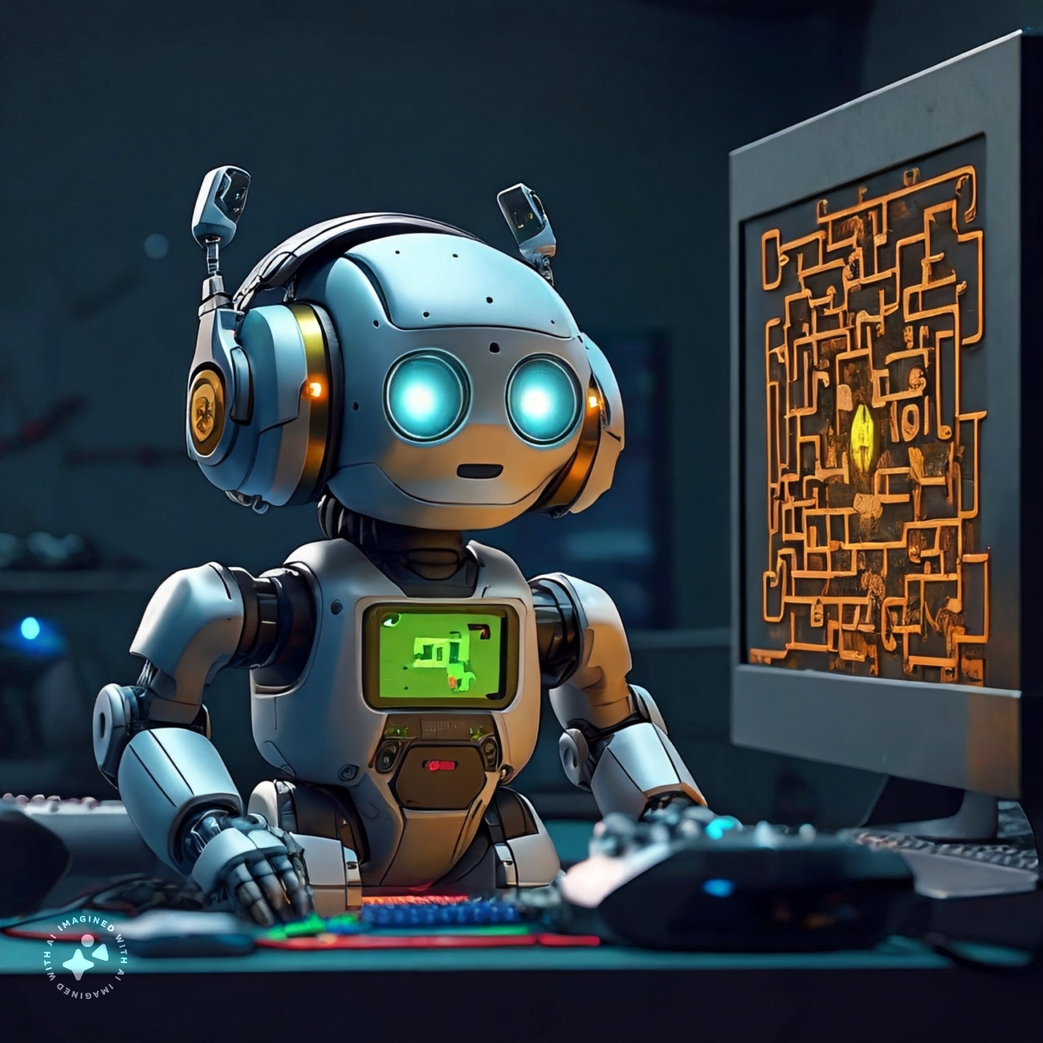
Complex Challenges in Gaming and Decision Theory
Games provide uncertain environments to test AI agents
Coping drives advances in key AI techniques: decision theory, reinforcement learning, planning
Notable examples: poker, Go, Atari - now applied in power grids, security, logistics
Game AI correlates with algorithmic advances
As AI expands into finance, social systems - game AI & human collaboration will advance progress
Notes:
Games provide an excellent testing ground for AI agents to handle uncertainty and complex decision-making. In games, the agent must operate with incomplete information about the environment, other players, and potential future states. This differs from more controlled AI problems like search and planning where the state space is fully observable.
Coping with this uncertainty requires sophisticated reasoning and decision frameworks that model probabilities and potential outcomes. As a result, research in game AI has driven advances in decision theory, reinforcement learning, probabilistic planning, and multi-agent systems.
Notable examples include modeling opponents and learning optimal strategies in poker, using Monte Carlo tree search for actions with hard-to-predict consequences in Go, and applying deep reinforcement learning to explore enormous state spaces in Atari games and Dota 2.
Beyond games, these techniques now power AI systems for critical applications like managing power grids, network security, logistics, and healthcare where operational dynamics introduce uncertainty. Game AI has essentially "levelled up" decision-making under uncertainty from a research problem to real-world viability.
The interactive yet uncertain nature of games provides an accessible way for human researchers to assess AI progress empirically. Game performance correlates with algorithmic advances better than abstract AI benchmarks. As AI is applied to unfamiliar but serious domains like finance or social systems, research in game AI and human-AI collaboration will have an expanding role in driving progress.

Slide 17
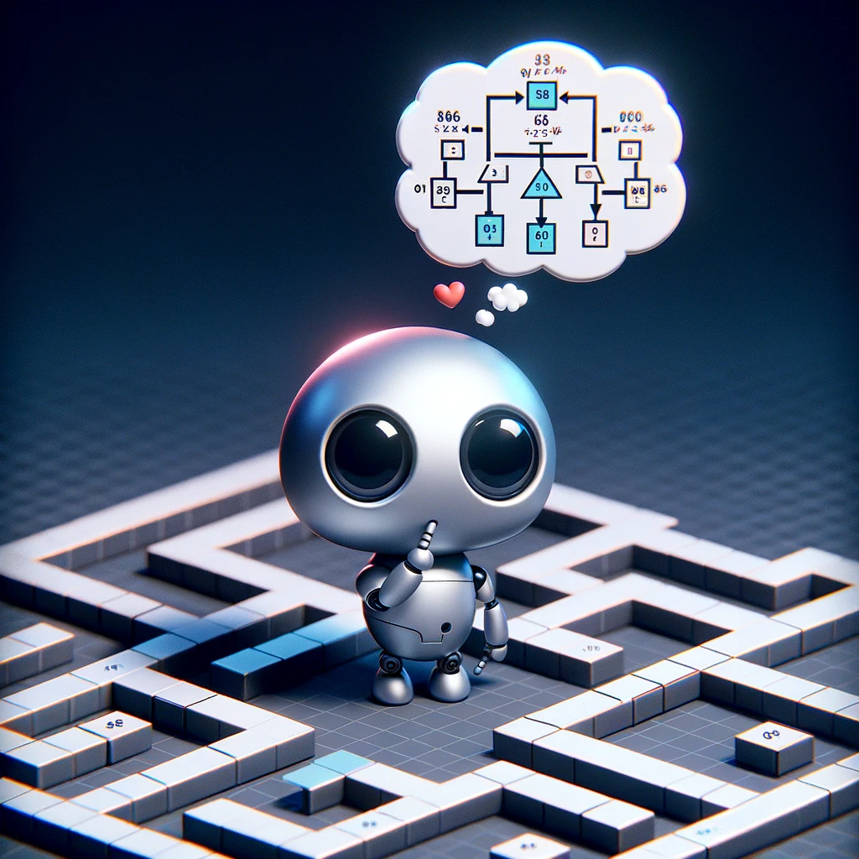
Markov Decision Making Process
Markov decision processes (MDPs) provide a mathematical framework for modeling decision-making in situations where outcomes are partly random and partly under the control of a decision-maker.
Applications:
Optimization Problems
Dynamic Programming
Reinforcement Learning

Slide 18
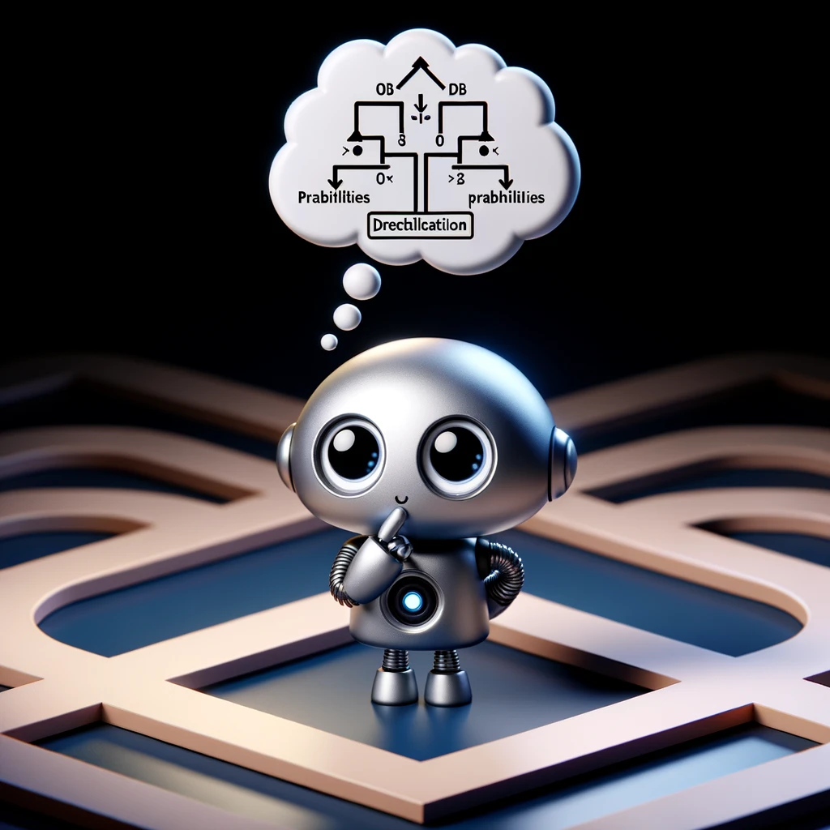
The Core of MDPs
States - Represent condition of environment
Actions - Agent's potential moves in each state
Rewards - Feedback for entering states
Transitions - Probabilities of state changes for actions
Together form MDP
Agents use MDP to learn policies - decision rules to maximize reward
Reinforcement learning with MDPs enables intelligent action selection
MDPs provide framework for sequenced decisions under uncertainty
Notes:
Markov Decision Processes provide a framework for AI agents to make sequences of decisions in uncertain, dynamic environments like games. They consist of a set of key elements:
States - A state captures the condition of the environment at a given point, encoding variables like a player's current health or position on a map. States in MDPs have the Markov property - the next state depends only on the current state and action taken.
Actions - From each state, the agent has to choose among one or more potential actions that alter its position and the state of the environment. For example, movement commands, using a weapon, opening a door. The set of allowable actions may differ across states.
Rewards - As the agent transitions between states along a trajectory, it earns numeric rewards or penalties based on the desirability of entered states. For instance, collecting a bonus item yields positive reward while running into danger cues negative reward.
Transitions - These encode the probability that taking a given action in a given state leads to entering another resultant state. Based on past environmental dynamics, the agent can learn a transition model.
Together, these 4 elements of states, actions, rewards and transitions form an MDP. By using reinforcement learning and planning with its MDP, an AI agent can determine optimal policies - decision rules for action selection per state that maximize long-term cumulative reward. This underpins intelligent behavior.

Slide 19
MDPs in Gaming Scenarios
Dynamic difficulty adjustment - Modulate game challenge level based on player state
Actions - Tune spawn rates, bonuses dynamically
Personalized gaming experience
Procedural content generation - Construct new world areas fit to player status
Actions - Introduce novel but navigable regions, useful items
Sustain engagement via optimized world expansion
In both cases, MDPs enable sequential, adaptive decisions
Learn policies to shape game based on interaction history
Handle AI need for uncertainty-aware choices
Notes:
MDPs enable game AI agents to make intelligent sequences of decisions that adapt to the dynamic game state. Two representative examples are:
Dynamic difficulty adjustment: Game developers integrate MDPs to modulate the game's challenge level based on the player's current skill and progress. The AI observes the states representing player health, assets acquired, enemies defeated and tunes spawn rates, bonuses granted, etc. accordingly by selecting from actions that alter difficulty. This provides an optimized, personalized game experience.
Procedural content generation: As players explore open worlds, MDP-based AI governs how new unseen regions are constructed procedurally. The state encodes the player's status, discovered areas. Rewards incentivize introducing novel but navigable areas and useful items. The transitions into new map states are generated by AI policies learned via the MDP to sustain engagement.
In both cases, the MDP allows the AI to choose successive actions that shape the game based on the player's interaction history. Learning policies enable probabilistic yet optimized decision-making as the game conditions evolve.
These examples demonstrate how MDPs handle gaming AI's need to make ongoing, adaptive decisions in response to uncertain player behavior and progression within complex, interactive environments.

Slide 20
AI's Advancements in Gaming
Sophisticated game AI enables rich, dynamic player experiences
Leverages decision frameworks (MDPs, reinforcement learning)
Realistic adaptable opponent behaviors, reactions
Dynamic difficulty adjustment matches player skills
Procedural content generation for personalized gameplay
Responsive narrative with choices that impact story arcs
Multiplayer environments evolve with collective player actions
Game AI benchmarks drive expectations for strategic applications
Notes:
Today's video games integrate sophisticated AI to deliver rich, dynamic and immersive experiences that respond intelligently to players and shape the gameplay narrative in real-time.
Equipped with statistical decision frameworks like MDPs and reinforcement learning, game AI systems can now:
Provide realistic opponent behaviors and reactions, like flanking maneuvers or adaptive formations in strategy games
Dynamically adjust game difficulty and pacing to match each player's skill, keeping the challenge engaging
Procedurally generate content like quests, items, or terrain that is novel yet balances playability
Craft complex narratives with branching story arcs that respond to moral choices and gameplay styles
The result is vibrant virtual worlds full of characters and challenges that feel "alive" thanks to AI. Multiplayer environments also adapt to the collective actions of communities.
Modern games are thus dynamic playgrounds that demonstrate how far AI strategy has progressed via decision theory and simulation. The benchmarks set by game AI only raise expectations for smart applications in business, science and society.

Slide 21

AI and Player Interaction
AI is not just an opponent but a collaborator in modern gaming.
AI pivotal for procedural content generation - enables unlimited novel game elements
Algorithms with decision frameworks probabilistically create:
Levels - varied layouts balanced for difficulty based on player models
Challenges - enemies, obstacles matched to each player’s skill tier
Narratives - branching storylines with continuity adapted to playstyles
Ever-refreshing tailored content via AI keeps games endlessly enjoyable
Systematically crafts unique gameplay experiences through simulation
Possibilities only limited by computing power for decision theory evaluation
Notes:
AI has become integral not just for controlling game characters, but actively creating customizable content to enhance replay value. Procedural content generation with AI opens unlimited possibilities to automatically develop novel game elements tuned to each player.
Algorithms equipped with decision frameworks can probabilistically generate:
Levels - AI can build platformer stages with varied layouts balanced for difficulty based on player models. Evolutionary algorithms select component placements using fitness metrics while adversarial generative networks create unpredictable but viable level chunks.
Challenges - MDPs help spawn enemies, obstacles, resource constraints tailored to the player's current skill tier and tech tree. The AI observes player states and selects appropriate actions to curate an engaging, personalized progression path.
Narratives - AI can render branching storylines with better continuity via planning algorithms and language models. Based on dialogue choices and mission orders, narrative graphs adapt to deliver a hero's journey or redemption arc catered to playstyles.
This ever-refreshing pipeline of tailored content keeps games endlessly enjoyable as AI systematically crafts novel gameplay experiences using simulations. The combinations possible are only limited by computing power to evaluate possibilities using decision theory.

Slide 22
Example
Meet Pepper - she's an AI teammate helping her human partner Alex play a maze exploration game.
In each room of the maze, Alex and Pepper have to open a door, discovering either a prize, an empty room, or a scary beast! They don't know what's behind each door...
Pepper could randomly open doors, but that might reveal dangerous beast rooms which cost Alex his lives!
Instead, Pepper uses an MDP to learn good policies. Her AI tracks:
Alex's lives/health left
Number of empty rooms opened recently
How many prizes they obtained so far
And remembers results for choices like:
Open the left door
Open the right door
Use a special key on a locked door
Notes:
Consider a simplified scenario from a dungeon crawler RPG. The AI controls a non-player character (NPC) ally that can support the main player character in battles. Its goal is to choose the best actions to aid the player effectively.
States:
Player health (high, medium, low)
Number of enemies remaining
NPC ally health
NPC ally energy
Actions:
Basic attack enemy
Heal player
Recharge ally energy
Use ally super power move
Rewards: +10 for defeating an enemy -5 for player losing health point +2 for recharging ally energy +15 for allowing ally super move
Transitions encode probabilities of resulting states per action.
By using reinforcement learning on this MDP, the NPC ally can discover an optimal policy. For example, when player health gets low prioritize healing over attacking. Or when multiple enemies remain, use the ally super move for maximum effect.
This allows the ally NPC AI agent to make intelligent, adaptive decisions that help the player progress based on the dynamics of each battle. The MDP provides the framework to learn policies attuned to the uncertainty of the game state trajectory.

Slide 23
Example Cont.
After some maze practice, Pepper knows opening locked doors tends to yield prizes more often when Alex is healthy. She avoids risky doors if Alex's lives are low, learning that cautious play lets them last longer!
So Pepper uses her MDP helper to make smart choices that match the uncertainty of what might come next! Her AI now has Alex's back.
Notes:
Consider a simplified scenario from a dungeon crawler RPG. The AI controls a non-player character (NPC) ally that can support the main player character in battles. Its goal is to choose the best actions to aid the player effectively.
States:
Player health (high, medium, low)
Number of enemies remaining
NPC ally health
NPC ally energy
Actions:
Basic attack enemy
Heal player
Recharge ally energy
Use ally super power move
Rewards: +10 for defeating an enemy -5 for player losing health point +2 for recharging ally energy +15 for allowing ally super move
Transitions encode probabilities of resulting states per action.
By using reinforcement learning on this MDP, the NPC ally can discover an optimal policy. For example, when player health gets low prioritize healing over attacking. Or when multiple enemies remain, use the ally super move for maximum effect.
This allows the ally NPC AI agent to make intelligent, adaptive decisions that help the player progress based on the dynamics of each battle. The MDP provides the framework to learn policies attuned to the uncertainty of the game state trajectory.

Slide 24
AI in Gaming
How AI is Pushing Gaming Forward

Slide 25
From Games to AI to AI for Games
Having explored the role of games in shaping AI, we now transition to understanding how AI, armed with sophisticated decision-making frameworks like decision theory and MDPs, is influencing and revolutionizing the gaming industry.

Slide 26
AI's Role in Content Creation
"Beyond gameplay, AI plays a pivotal role in content creation for games. Here, we explore how AI uses decision theory and MDPs to generate dynamic content, such as levels, challenges, and narratives, making each game unique and re-playable."
Notes:
Artificial Intelligence in gaming has transcended beyond mere preprogrammed responses. It is now about creating an ecosystem that reacts, adapts, and personalizes the gaming experience in real-time. In this segment, we examine how AI employs decision theory and Markov decision processes (MDPs) to deeply interact with players, creating a gaming environment that is as unique as the individual at the controls.
Interactive AI Dynamics:
AI analyzes player behavior to modify game difficulty and pacing.
Real-time adaptation ensures challenges are tailored to player skill level.
Personalized Gameplay:
Decision theory allows AI to offer choices that resonate with individual player preferences.
AI customizes in-game events and missions based on player actions and history.
Engagement Through Adaptation:
MDPs enable AI to predict and react to player decisions, crafting a responsive game narrative.
The game environment evolves based on player interaction, keeping the experience fresh and engaging.
Creating Unique Player Journeys:
Decision theory and MDPs work together to create a multitude of potential paths and outcomes.
Every playthrough becomes a unique journey, shaped by the player's decisions and interactions.
Through the integration of decision theory and MDPs, AI becomes a dynamic participant in the gaming experience, providing not just a challenge, but a responsive, evolving, and deeply personal adventure. It's this intelligent interaction that makes modern gaming an endlessly engaging experience, inviting players back time and again to see how their unique journey unfolds.

Slide 27
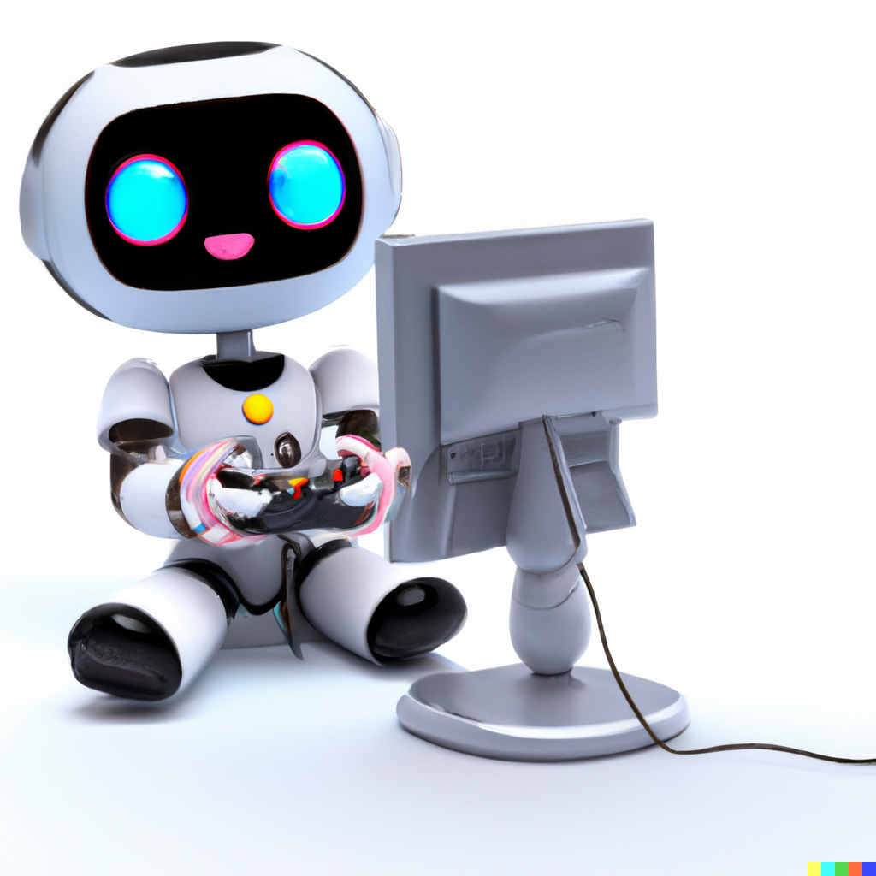
AI's Adaptive and Personalized Gaming
Enhancing Gameplay Realism
AI contributes to creating more realistic game environments, enhancing the overall gaming experience.
Tailoring Gameplay Challenges
AI customizes challenges and difficulty levels based on individual player skills and preferences.
Anticipating Player Actions
AI predicts and adapts to player actions, creating personalized and dynamic gaming scenarios.

Slide 28
AI's Role in Creating Immersive Narratives
"As we look to the future, the potential of AI in gaming, powered by advanced decision-making frameworks, is boundless.

Slide 29
AI's Predictive Capabilities in Gaming
"Predictive AI transforms how games are designed and played.
AI anticipates player actions and preferences, using decision theory and MDPs to create more engaging and immersive gaming environments."

Slide 30
Creating Immersive Narratives
Narratives in games are no longer static, thanks to AI.
AI uses decision theory and MDPs to create dynamic narratives that adapt to player choices, making each gaming journey unique and personal."

Slide 31
Games as a Platform for Advancing Speech Recognition:
Certain games have integrated speech recognition to enhance player interaction, pushing for advancements in speech recognition technology to better understand and process natural language inputs in real-time gaming scenarios.

Slide 32

Voice Recognition in Games-History
Early 2000s: Basic voice commands in gaming (e.g., Tom Clancy's EndWar)
2010s: Integration of voice-activated virtual assistants (e.g., Kinect for Xbox)
Late 2010s: Advanced NLP algorithms enabling more natural conversations (e.g., branching dialogues)
2020s: Real-time speech recognition and emotional tone analysis for immersive experience
Voice Recognition Video

Slide 33
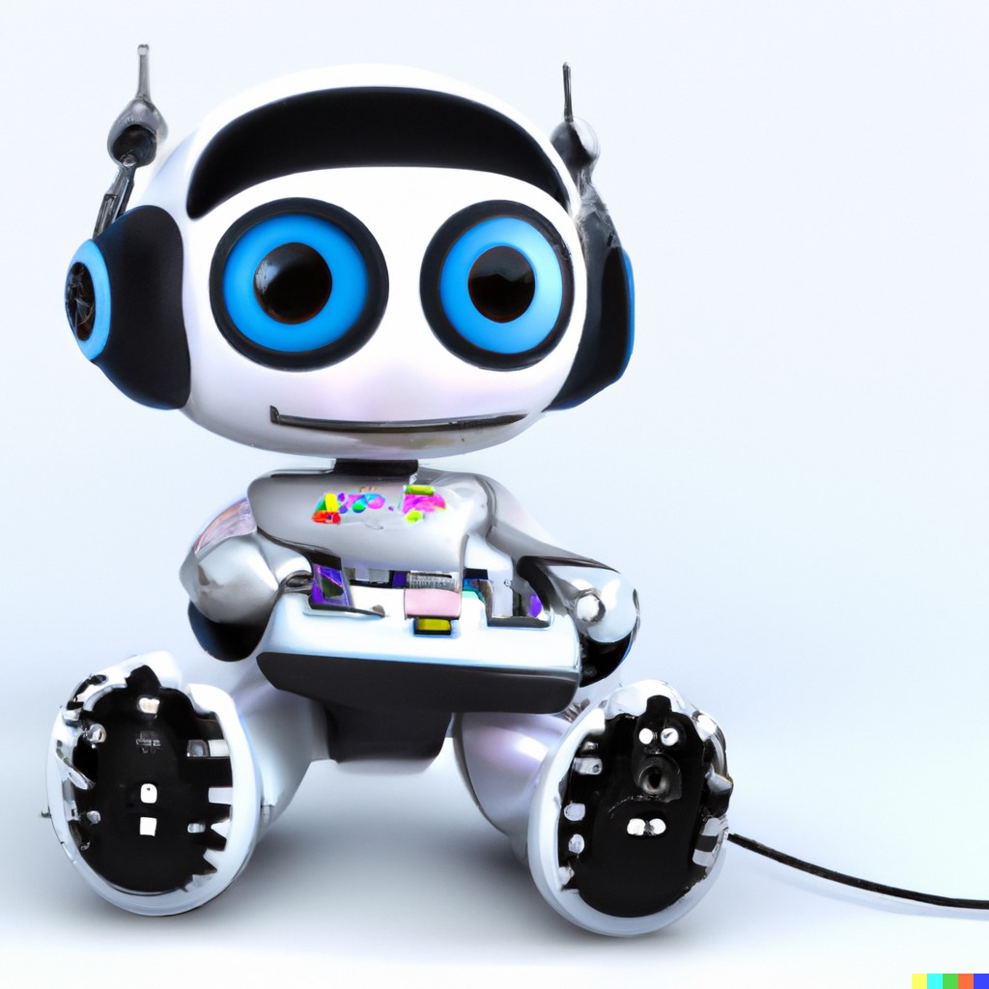
Voice Recognition in Games: Importance
Data Collection: Games offer a diverse dataset for accents, dialects, and languages.
Natural Interaction: Pushes AI research on understanding natural language and context.
User Experience: Gamers expect intuitive interfaces; provides motivation for advanced AI solutions.
Simulation & Training: Games as a sandbox for testing and improving AI algorithms.
Ethics & Bias: Real-world testing grounds for ensuring fairness and avoiding biases in voice recognition

Slide 34
Speech Recognition Contributing to Game Development
As speech recognition technology advanced, it found its way into game development, allowing for new gameplay mechanics. Games started to include voice-controlled actions, providing a more immersive and hands-free gaming experience.

Slide 35
Mutual Technological Growth:
The needs of game development have at times driven innovation in speech recognition, such as the need for accurate, low-latency processing of voice commands in games.
Conversely, as speech recognition technology improved, it expanded the possibilities for game developers to include more natural and intuitive voice interactions in games.
Notes:
Both fields continue to evolve, often benefiting from the technological advancements of the other. Speech recognition now plays a critical role in the accessibility of games, allowing for broader audiences, including those with disabilities, to enjoy gaming experiences. Meanwhile, the gaming industry's demand for better and more integrated speech interactions pushes the boundaries of what speech recognition technology can achieve.

Slide 36
Deep Insights 1 of 2
David Silver: The Man Behind AlphaGo and Alpha Zero – Lex Friedman Interview
Notes:
AlphaZero is a computer program developed by artificial intelligence research company DeepMind to master the games of chess, shogi and go. This algorithm uses an approach similar to AlphaGo Zero. On December 5, 2017, the DeepMind team released a preprint introducing AlphaZero, which within 24 hours of training achieved a superhuman level of play in these three games by defeating world-champion programs Stockfish, Elmo, and the 3-day version of AlphaGo Zero. In each case it made use of custom tensor processing units that the Google programs were optimized to use. AlphaZero was trained solely via "self-play" using 5,000 first-generation TPUs to generate the games and 64 second-generation TPUs to train the neural networks, all in parallel, with no access to opening books or endgame tables. After four hours of training, DeepMind estimated AlphaZero was playing at a higher Elo rating than Stockfish 8; after 9 hours of training, the algorithm defeated Stockfish 8 in a time-controlled 100-game tournament The trained algorithm played on a single machine with 4 TPUs.
https://www.youtube

Slide 37
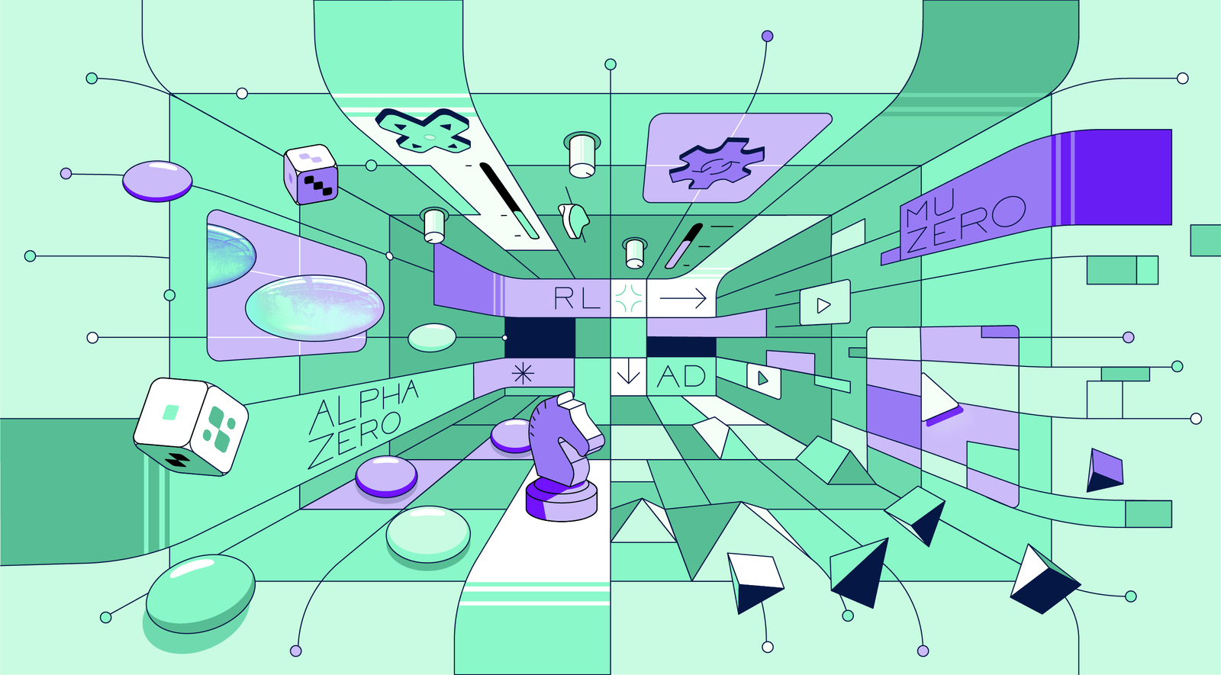
Deep Insights 2 of 2
Check out Google Deep Minds website
Read this Paper
Notes:
Both AlphaGo and AlphaStar are seminal works demonstrating the power of combining deep learning with reinforcement learning to solve complex problems. While the specifics of their architectures and training procedures differ due to the nature of the games they are designed for, they both represent major advancements in the field of AI and have broad implications for the applicability of deep reinforcement learning in various domains

Slide 38
Game Development
The PC Revolution
1990s: Rise of personal computers, enabling genres like MMORPGs.
Mobile and Social Gaming
2000s: Facebook games and mobile platforms redefine casual gaming.
Virtual Reality & Cloud
2010s-Present: VR headsets, cloud gaming, and live service games.
https://www.youtube.com/watch?v=8FHBh_OmdsM

Slide 39
Current Trends
Cloud Gaming: Automation in resource allocation and scaling.
Game Streaming: Automated curation and recommendation systems.
eSports: Automated systems for scoring, judgment, and anti-cheating measures.
Blockchain: Automated smart contracts for digital ownership.

Slide 40
Future Possibilities
Metaverse: Fully-automated, expansive, interconnected digital worlds.
Quantum Computing: Potential for vastly more complex and nuanced automation.
Biometric Integration: Personalized gaming experiences based on real-time biometric data.
Ethical AI: Automating complex decision-making scenarios in a morally responsible way.

Slide 41
AI in games has evolved from simple rule-based systems to sophisticated algorithms capable of learning, adapting, and generating new content, significantly enriching the gaming experience

Slide 42
Article: “A general reinforcement Learning Algorithm” …
Big Idea: Is AlphaStar AGI?
Leadership
https://www.youtube.com/watch?time_continue=1&v=aFwVf5a3pZM&feature=emb_logo
Video: Deepmind
https://www.youtube.com/watch?v=cUTMhmVh1qs&t=18s

Slide 43
Assignments
A03 – 1 to 2 pages report on what AlphaStar cannot do.

Slide 44
Lab 03
Scratch Game Creation

Slide 45
Puzzle P03
The key to this puzzle is Bayes theorem, which speaks to probabilities (uncertainties) as they are modified with a gain in information.
Called the Monty Hall Problem: To Switch or Not to Switch?

